Slide 1



Chandigarh University
WELCOME
TO
OUR PROJECT PERSENTATION
WeBlog

Slide 2

SUBMITTED TO:-
NEHA MAAM
JAGMEET MAAM
SUBMITTED BY:-
Tushar S Verma(20BCS2104)
Himanshu Sharma(20BCS2178)
Manish pavadiya(20BCS2243)
Shivam Anand(20BCS2124)

Slide 3
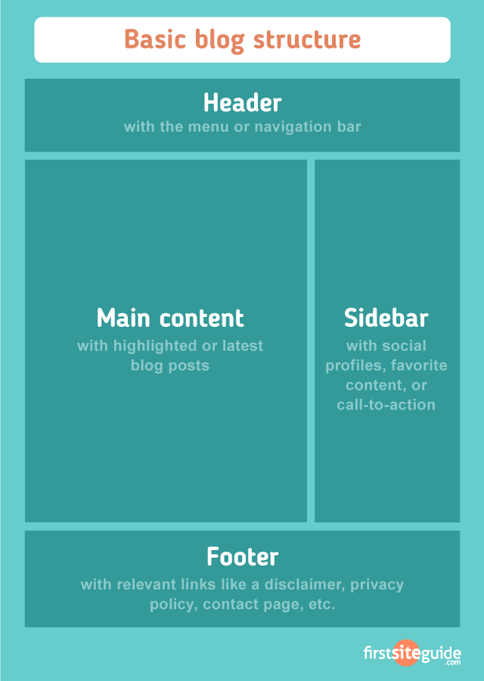
INTRODUCTION:
We have created a website which provides you articles on various topics like tech, sports, fashion,etc..
To keep your knowledge up to date. People are intrested in writing you can submit your own article which upon approval will be up on our website and you can get a good amount of reach from here!

Slide 4

OBJECTIVE:
To create a platform where people can read articles on various topics.
To create a platform where writers can post there content online.

Slide 5




HARDWARE/SOFTWARE USED:
Visual Studio Code
XAMPP
Google Chrome
My SQL Server

Slide 6



TECHNOLOAGE USED:
HTML
HTML stands for Hyper Text Markup Language.
HTML is the standard markup language for creating Web pages.
HTML describes the structure of a Web page.
CSS
CSS stands for Cascading Style Sheets.
CSS describes how HTML elements are to be displayed on screen,
paper, or in other media.
CSS saves a lot of work. It can control the layout of multiple web pages
all at once.

Slide 7


Java Script
JavaScript is a text-based programming language used both on the client-side and server-side that allows you to make web pages interactive.
JavaScript gives web pages interactive elements that engage a user.
PHP
PHP is an acronym for "PHP: Hypertext Preprocessor"
PHP is a widely-used, open source scripting language
PHP scripts are executed on the server

Slide 8

SQL
SQL stands for Structured Query Language
SQL lets you access and manipulate databases

Slide 9

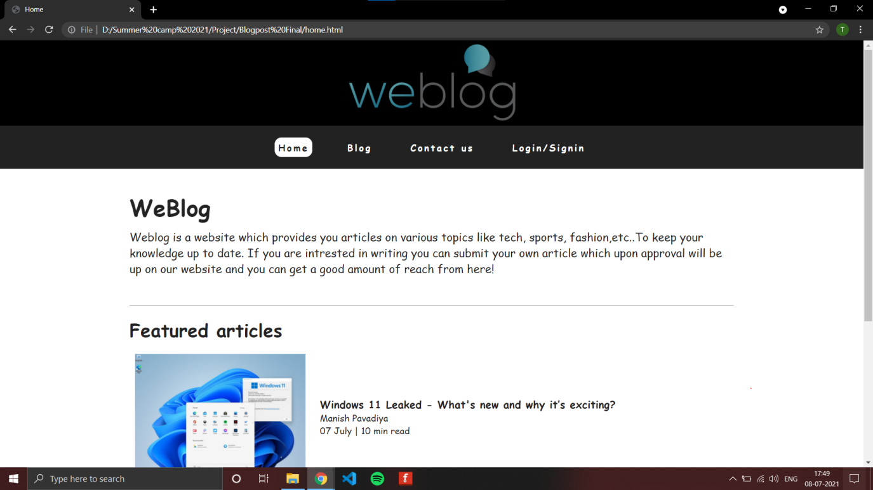
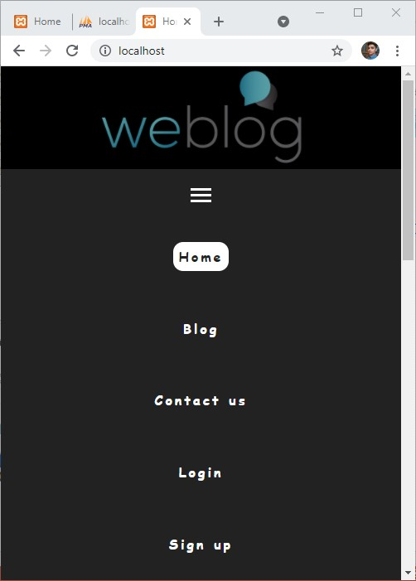
SNAPSHOTS

Slide 10
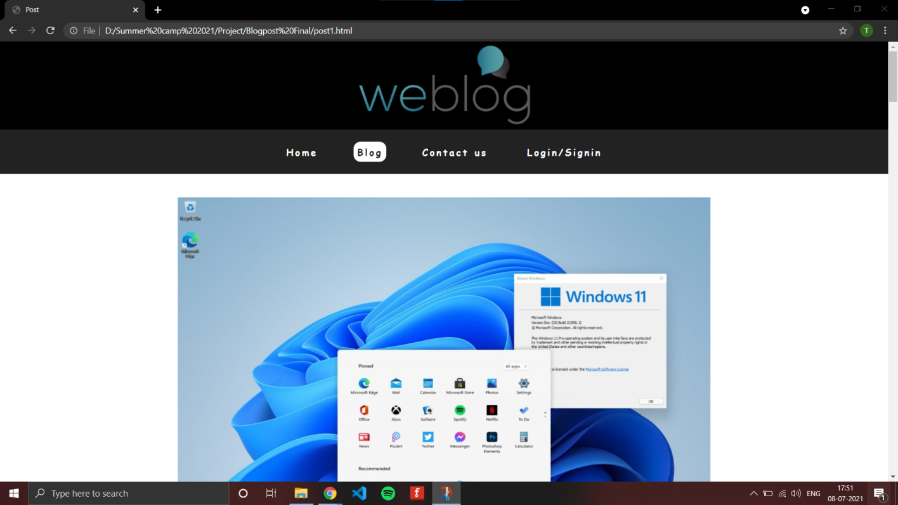
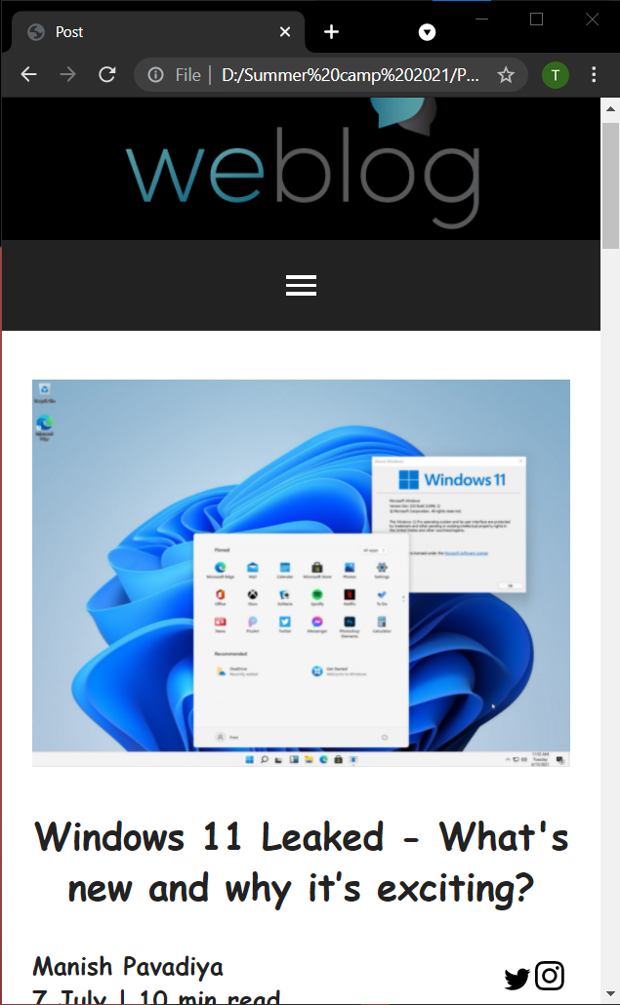

Slide 11
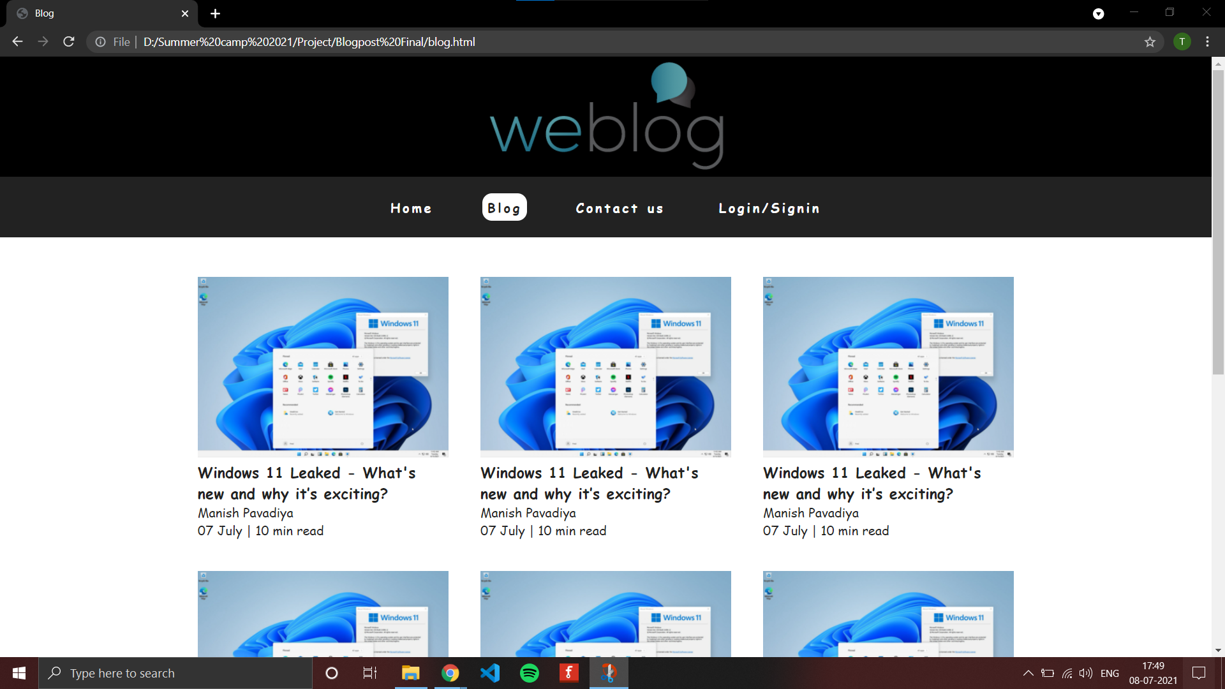
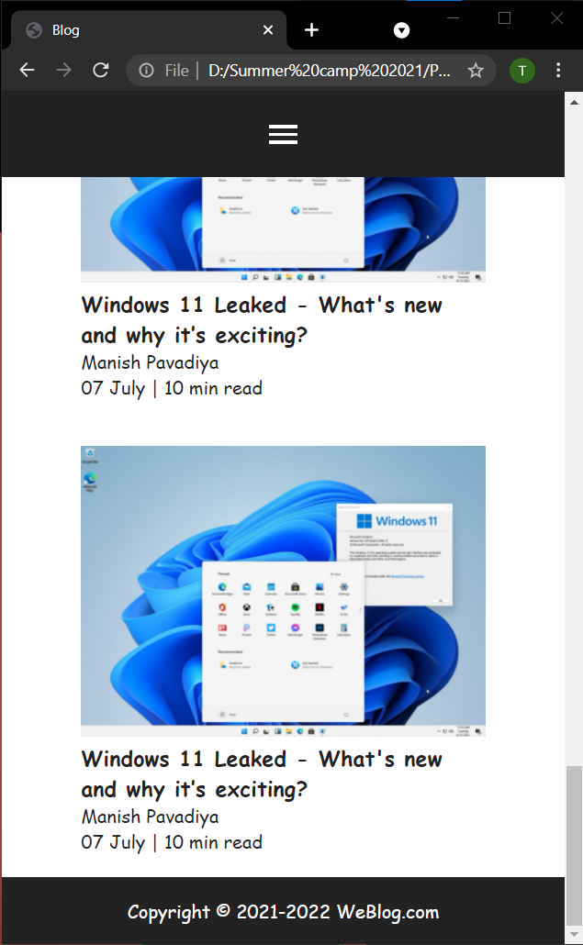

Slide 12
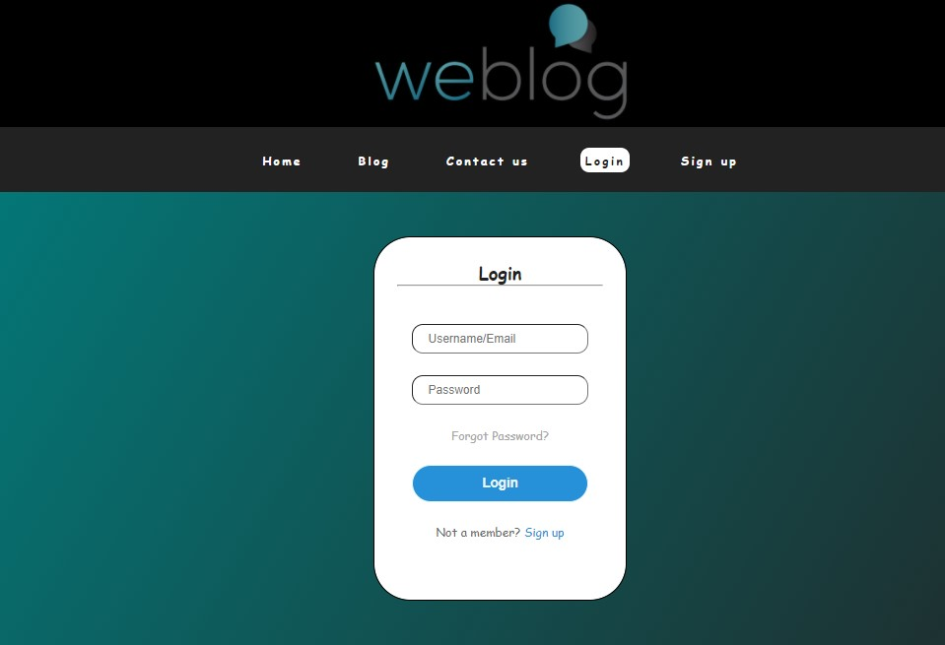
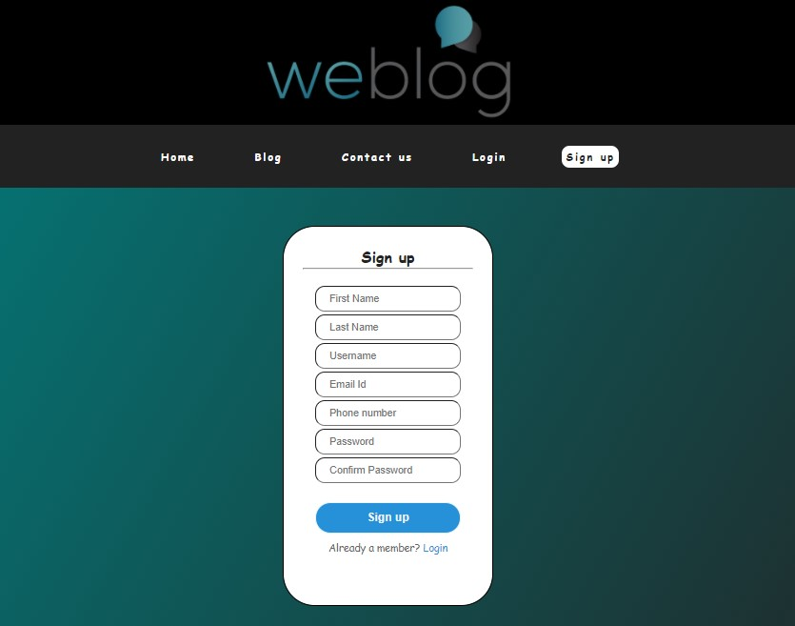

Slide 13
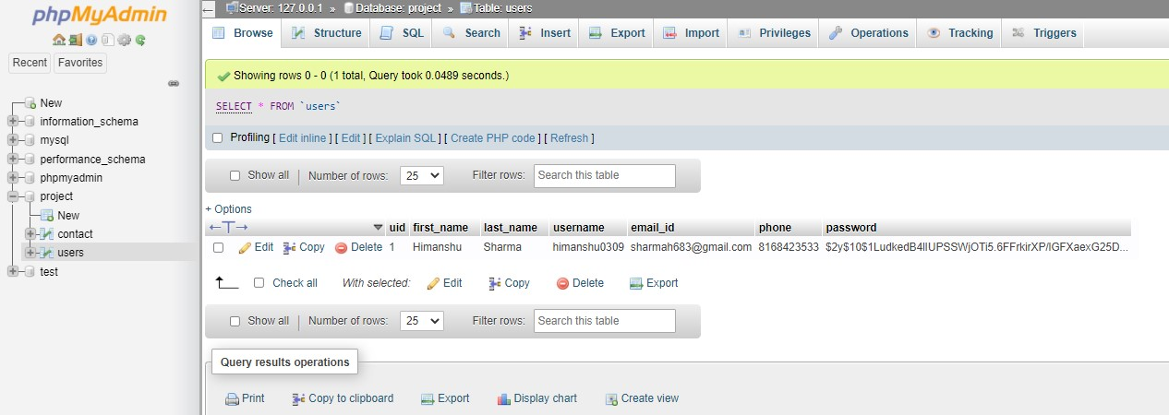

Slide 14
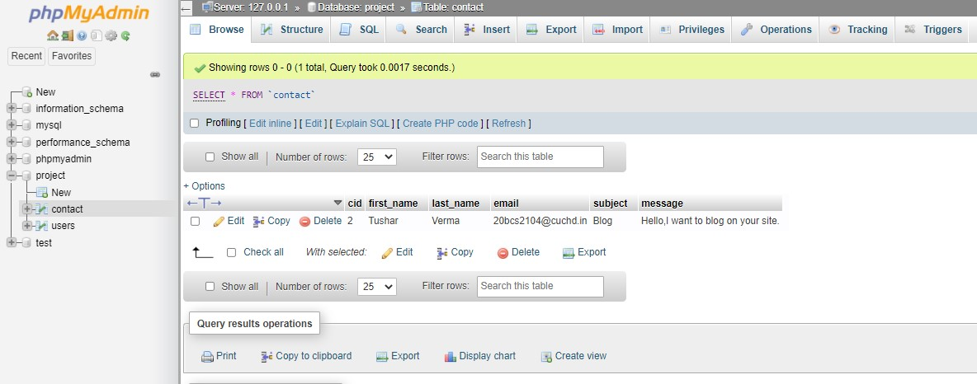

Slide 15
IN FUTURE:
In future we are going to add comments feature to our blogpost. Through comments we get viewers responses towards our articles
In future we will add search bar so that user can find a particular blog.
In future anyone can upload their article directly to the website.

Slide 16


